Slide 1
Dependencies
Resource Server
Authentication Server
<dependency>
<groupId>org.springframework.boot</groupId>
<artifactId>spring-boot-starter</artifactId>
</dependency>
<dependency>
<groupId>org.springframework.boot</groupId>
<artifactId>spring-boot-starter</artifactId>
</dependency>
<dependency>
<groupId>org.springframework.boot</groupId>
<artifactId>spring-boot-starter-oauth2-client</artifactId>
</dependency>
<dependency>
<groupId>org.springframework.boot</groupId>
<artifactId>spring-boot-starter-thymeleaf</artifactId>
</dependency>
<dependency>
<groupId>org.springframework.boot</groupId>
<artifactId>spring-boot-starter-web</artifactId>
</dependency>
<dependency>
<groupId>org.thymeleaf.extras</groupId>
<artifactId>thymeleaf-extras-springsecurity5</artifactId>
</dependency>
<dependency>
<groupId>org.springframework.boot</groupId>
<artifactId>spring-boot-starter</artifactId>
</dependency>
<dependency>
<groupId>org.springframework.cloud</groupId>
<artifactId>spring-cloud-starter-oauth2</artifactId>
<version>2.2.4.RELEASE</version>
</dependency>
<dependency>
<groupId>org.springframework.boot</groupId>
<artifactId>spring-boot-starter-web</artifactId>
</dependency>

Slide 2
Dependencies
Resource Server
Authentication Server
WebController.java
Create a controller for human interaction
Create 2 endpoints for the webpages
CompanyController.java
Create a controller for API
Create 1 endpoint for the API
AuthServerConfig.java
Communication of the token to the resource server
Creation of the token
Save ClientID and ClientSecret
UserController.java
Returns the Principal
SecurityConfiguration.java
Configure the securityHttp
Call the login of the Oauth 2
ResourceLoginApplication.java
Initialize the application
SecurityConfiguration.java
Configure the securityHttp
Authentication of users
Creation of the encoder of the password
AutenticationLoginApplication.java
Initialize the application
Others files *.html and files related with the API
application.yml
application.properties

Slide 3
Interaction Resource – Authentication normal
User
Client Application
Authentication Server
Resource Server
1. Request a resource
2. Auth code request
3. Login page
4. User login
5. Auth code
6. Exchange Code for token
7. Access token
8. API call with access token
9. Validate token
10. API response if token valid

Slide 4
Interaction Resource - Authentication
User
Resource Server and ClientAPP
Authentication Server
1. Request a resource
2. Auth code request
3. Login page
4. User login
5. Auth code
6. Exchange Code for token
7. Access token
8. API call with access token
9. Validate token
10. API response if token valid

Slide 5
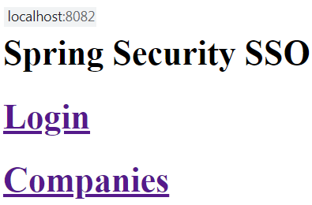
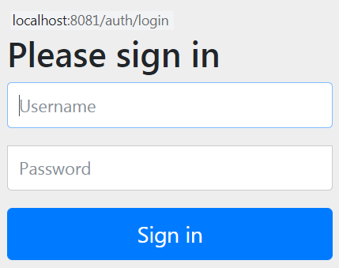
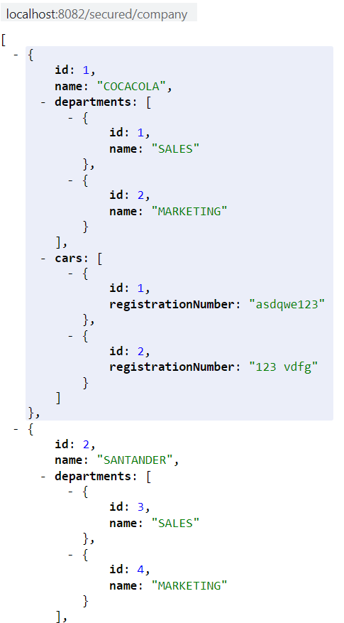
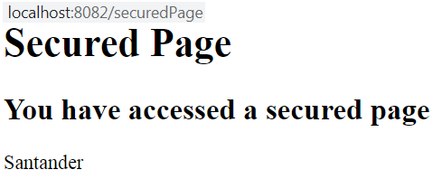
Interaction Resource - Authentication
Login click
Companies click

